Slide 1

INSTITUTE :UIE
DEPARTMENT: ACADEMIC UNIT 1&4
Bachelor of Engineering (Computer Science & Engineering)
Subject Name and Code:
Quantum and Semiconductor Physics Lab
20SPP-182
Prepared by: Ms. Jagdeep Kaur, Assistant Prof. Physics
DISCOVER . LEARN . EMPOWER
VELOCITY OF ULTRASONIC SOUND

Slide 2
Importance of Advanced Engineering Physics
The electrical devices which are used as home appliances are based on physics rules and laws.
Automobile technology is based on the principle of thermodynamics.
Lasers are widely used in medical sciences.
Radar technology is based on the rules of Physics.
Nuclear energy is used on a large scale to produce electric power.

Slide 3
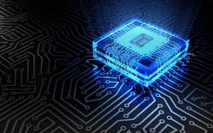
COURSE OBJECTIVES
To train engineering students in basics of measurements and the instruments.
To give practical training on basic Physics experiments which are useful to engineers.
To equip the students with practical knowledge in electronics and optics.
Figure 1 [1]

Slide 4
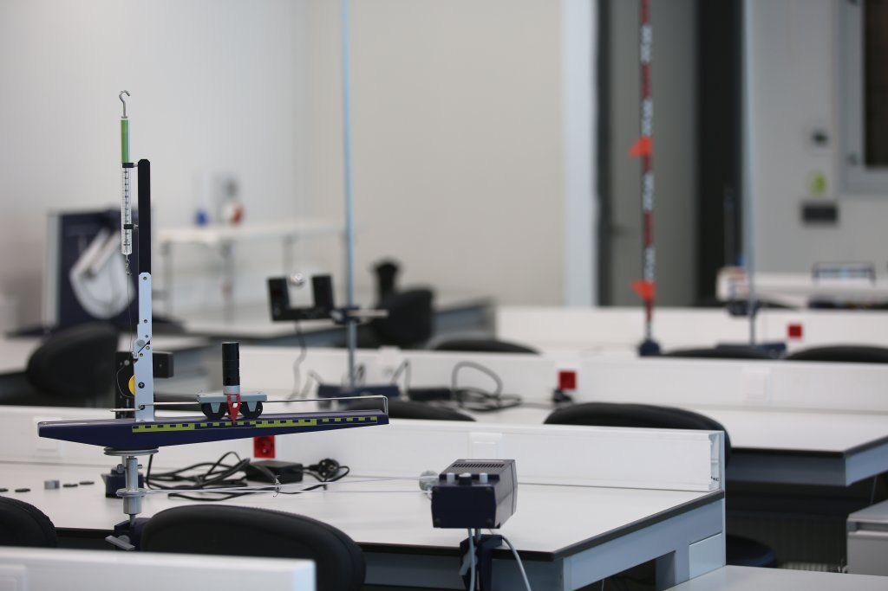
COURSE OUTCOMES
CO Number | Title On completion of this course, the students are expected to learn | Level
CO1 | It will provide the modest experience that allows students to develop and improve their experimental skills and develop ability to analyze data. | Understand Applying Analyze
CO2 | Ability to demonstrate the practical skill on measurements and instrumentation techniques of some Physics experiments. Students will develop the ability to use appropriate physical concepts to obtain quantitative solutions to problems in physics. | Understand Applying Analyze
CO3 | Students will demonstrate basic experimental skills by setting up laboratory equipment safely and efficiently, plan and carry out experimental procedures, and report verbally and in written language the results of the experiment. | Understand Applying Analyze
Figure 2 [2]

Slide 5
LIST OF EXPERIMENTS
To determine the Hall Voltage and Hall Coefficient Using Hall Effect.
To determine the resistivity of semiconductors by four probe Method.
To draw the static current- voltage characteristics of a Zener diode.
To calculate the frequencies at constant intensity for material using photoelectric effect.
To determine the diffraction using LASER beam and find the grating element of diffraction grating.
To determine the numerical aperture of optical Fiber.
To find the divergence of LASER beam.
Determination of ‘h’ using photocell.
To find the velocity of ultrasonic wave in the given liquid.
Investigating the Doppler Effect with ultrasonic waves.

Slide 6
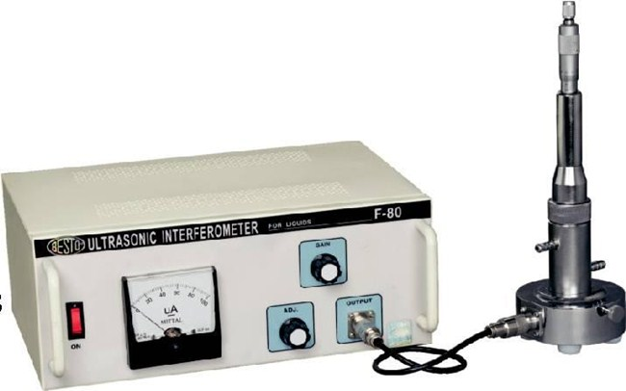
EXPERIMENT TO BE DISCUSSED…
To calculate the velocity of ultrasonic sound through water media.
Figure 3 Different components of Ultrasonic Interferometer Apparatus [3]

Slide 7
AIM: To calculate the velocity of ultrasonic sound through different liquid media.
List of Equipment Used:
Table 1: List of Equipments
S.N. | Equipment | Range | Quantity
 | Ultrasonic interferometer | 2MHz | 1
2. | Sample liquids | 20ml | 1
3. | Power supply | 220V | 1

Slide 8
Pre-preparation/ Prerequisite
Student is advised to understand the following aspects before carrying out the experiment:
Students should know about the sound waves, their properties, ultrasonic wave generation and detection.
Student should know the working of ultrasonic spectrometer and its components.

Slide 9
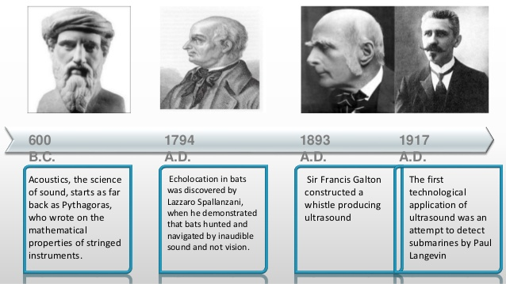
Discovery

Slide 10
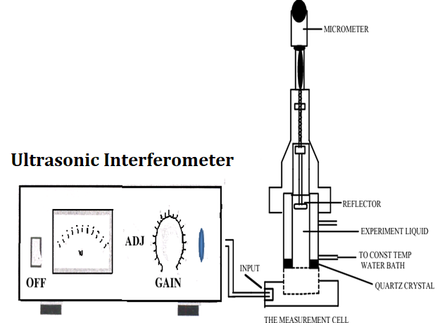
What is Ultrasonic Interferometer?
In an ultrasonic interferometer, the ultrasonic waves are produced by the piezoelectric method.
In a fixed frequency variable path interferometer, the wavelength of the sound in an experimental liquid medium is measured, and from this one can calculate its velocity through that medium.
Figure 4: Detail of different parts of Ultrasonic Interferometer [4]

Slide 11
Theory
Ultrasonic interferometer is a simple device which yields accurate and consistent data, from which one can determine the velocity of ultrasonic sound in a liquid medium.
Ultrasonic: Ultrasonic sound refers to sound pressure with a frequency greater than the human audible range (20Hz to 20 KHz). When an ultrasonic wave propagates through a medium, the molecules in that medium vibrate over very short distance in a direction parallel to the longitudinal wave. During this vibration, momentum is transferred among molecules. This causes the wave to pass through the medium.
Generation of ultra-sound: Ultrasonic can be produced by different methods. The most common methods include:
Mechanical Method: In this, ultrasonic frequencies upto 100KHz are produced. But this method is rarely used due to its limited frequency range.

Slide 12
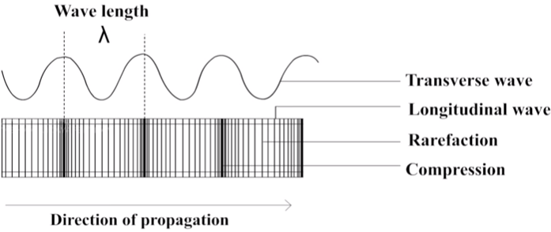
Piezoelectric Generator: This is the most common method used to produce ultrasound. When mechanical pressure is applied to opposite faces of certain crystals which are cut suitably, electric fields are produced. Similarly, when subjected to an electric field, these crystals contract or expand, depending on the direction of the field. Thus, a properly oriented rapid alternating electric field causes a piezoelectric crystal to vibrate mechanically. This vibration, largest when the crystal is at resonance, is used to produce a longitudinal wave, i.e. a sound wave.
Magnetostriction Generator: In this method, the magnetostriction method is used to produce ultrasonic. Frequencies ranging from 8000 Hz to 20,000Hz can be produced by this method.
Figure 5 Ultrasonic wave propagation [5]

Slide 13
Ultrasonic Interferometer: In an ultrasonic interferometer, the ultrasonic waves are produced by the piezoelectric method. In a fixed frequency variable path interferometer, the wavelength of the sound in an experimental liquid medium is measured, and from this one can calculate its velocity through that medium. The apparatus consists of an ultrasonic cell, which is a double walled brass cell with chromium plated surfaces having a capacity of 10ml. The double wall allows water circulation around the experimental medium to maintain it at a known constant temperature.
The micrometer scale is marked in units of 0.01mm and has an overall length of 25mm. Ultrasonic waves of known frequency are produced by a quartz crystal which is fixed at the bottom of the cell. There is a movable metallic plate parallel to the quartz plate, which reflects the waves. The waves interfere with their reflections, and if the separation between the plates is exactly an integer multiple of half-wavelengths of sound, standing waves are produced in the liquid medium. Under these circumstances, acoustic resonance occurs. The resonant waves are a maximum in amplitude, causing a corresponding maximum in the anode current of the piezoelectric generator.

Slide 14
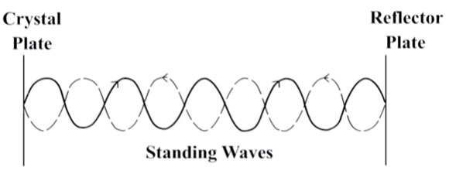
Procedure
Insert the quartz crystal in the socket at the base and clamp it tightly with the help of a screw provided on one side of the instrument.
Unscrew the knurled cap of the cell and lift it away. Fill the middle portion with the experimental liquid and screw the knurled cap tightly.
Then connect the high frequency generator with the cell.
There are two knobs on the instrument- “Adj” and “Gain”. With “Adj”, position of the needle on the ammeter is adjusted. The knob “Gain” is used to increase the sensitivity of the instrument.
Figure 6 Standing waves are produced between crystal plate and reflector [5]

Slide 15
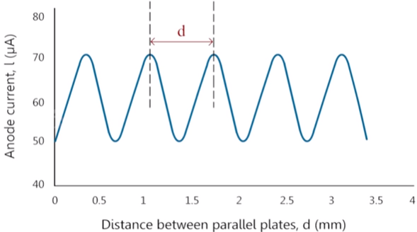
Procedure
Then ultrasonic waves are reflected back from the movable plate, and standing waves are formed between the quartz crystal and the reflector plate.
Figure 7 Distance ‘d’ between parallel plates [5]
The micrometer screw is moved till the anode current reaches maximum.
Micro ammeter readings are noted for ‘n’ number of maxima / minima.
The distance ‘d’ between two successive maxima and minima is obtained from the readings taken.
The wavelength of the ultrasound is calculated using the ‘d’ value and hence velocity of the ultrasonic wave can be calculated using the known frequency.

Slide 16

Formula used
If d is the separation between successive adjacent maxima of anode current, then,
d = $\frac{\text{λ}}{2}$
We have, the velocity (v) of a wave is related to its wavelength (λ) by the relation,
v= λ f where f is the frequency of wave.
Then,
v= λ f = 2df

Slide 17
Observations & Calculations:-
Observations and Calculations:
Least count of the main scale = ……… mm
Least count of circular scale = ……… mm
Least count of vernier scale = ……… mm
Frequency of the ultrasound used (f) = 2MHz

Slide 18
Table 2:
S.NO. | Micrometer Reading Corresponding to maxima/minima (mm) | Difference between consecutive Maxima/Minima d=λ/2 (mm)
1 | N1 | N2-N1
2 | N2 | N3-N2
3 | N3 | N4-N3
4 | N4 | N5-N4
5 | N5 | Mean d=
The velocity of ultrasonic waves is calculated as v=λ f=2df =………ms⁻¹
Standard velocity of ultrasonic waves is =1480m/s

Slide 19
Result & Discussion
Result:-
The velocity of the ultrasonic wave through the given liquid medium = ......... ms⁻¹.
Conclusion
In conclusion, Ultrasonic waves move with a very high speed. That is why, the standard velocity of ultrasonic waves is =1480 m/s

Slide 20
Viva voce
What are the ultrasonic waves?
What do you understand by Ultrasonic Interferometer?
How many types of generation methods of ultrasonic waves?
In what units Ultrasonic velocity is measured?
What is the value of density of water as a medium?
Why ultrasonic waves are not audible to humans?
What do you mean by standard value of ultrasonic waves in water as a medium?

Slide 21
Simulation and video links
Simulation Link:-
https://vlab.amrita.edu/?sub=1&brch=201&sim=803&cnt=4
Link for related video: -
https://youtu.be/MD_zkNzF3eA
https://youtu.be/UG-pzCUsEq0
https://youtu.be/eWJNZcZszkM
https://youtu.be/2lyrstdRfLU

Slide 22
Evaluation Pattern
Sr. No. | Parameters | Maximum Marks | Marks Obtained
1. | Worksheet completion including writing learning objectives/Outcomes. (To be submitted at the end of the day) | 10
2. | Post Lab Quiz Result. | 5
3. | Student Engagement in Simulation/Demonstration/Performance and Controls/Pre-Lab Questions. | 5
4. | Total Marks | 20
5. | Teacher’s Signature (with date)

Slide 23
References
[1] https://images.app.goo.gl/onXTfVDfo1WiwTcK9
[2] https://in.pinterest.com/pin/842243567793191631/
[3] http://bestoinstruments.com/product/01598.jpg
[4]https://www.researchgate.net/publication/322992337_Introduction_of_ultrasonic_interfero meter_and_experimental_techniques_for_determination_of_ultrasonic_velocity_density_viscosity_and_various_thermodynamic_parameters
[5] https://youtu.be/MD_zkNzF3eA

Slide 24
THANK YOU
For queries
Email: jagdeep.uis@cumail.in

